Slide 1
Research paper Reading
GAURAV SETTY
SAMIRASIMHA RAJASIMHA

Slide 2
Efficient Public Key Encryption With Outsourced Equality Test for Cloud-Based IoT Environments
Background and Research problem
Approach and Contributions
Re-implementation of the work
Enhancement
Learning Outcomes

Slide 3
BACKGROUND
The development of wireless sensor networks, telecommunications, and informatics has led to the realization of pervasive intelligence, which envisions the future Internet of Things (IoT) with thousands or millions of intelligent devices or "things" becoming a norm in our interconnected world.
Cloud computing technologies provide an affordable and real-time computing and storage capability, making cloud-based IoT systems a promising architecture in modern society.
Cloud-based IoT systems bring a number of security challenges, especially with searching on encrypted data, which is challenging given today's technology. To overcome these challenges, searchable encryption has emerged as one of the important research fields.

Slide 4
BACKGROUND
Public Key Encryption with Equality Test (PKEET) is introduced to protect the data security while providing privacy-preserving equality search mechanism on encrypted data.
PKEET has been widely studied and applied in many practical applications, such as intelligent encrypted email monitoring, encrypted database partition, IoT data protecting, and more.
PKEET schemes are facing challenges in scenarios where an untrustworthy cloud server may conduct data analysis by itself instead of the entrusted party, which may leak sensitive information.
Offline Message Recovery Attack (OMRA) is another concern where the cloud server could guess the IoT data based on the returned query results.

Slide 5
BACKGROUND
These problems have not been considered in PKEET schemes in the literature, and even applying the framework of two non-colluded entrusted parties to resist OMRA would lead to insecure or unrealistic applications.
New solutions are needed to address these security challenges and ensure the privacy and security of IoT data in cloud-based IoT systems.

Slide 6
Research problem
This research highlights the limitations of existing schemes and proposes a new scheme called Public Key Encryption With Outsourced Equality Test (PKE-OET) that addresses some of these limitations.
The scheme is motivated by a scenario in a medical health social network where patients' data needs to be securely stored and analyzed while preserving their privacy.
This method addresses the challenge of an untrustworthy cloud server that may be interested in the query results and conduct data analysis by itself instead of the entrusted party.

Slide 7
approach
Encryption and storage of ciphertexts.
Sender generates ciphertexts using receiver's public key and stores them in the proxy.
Receiver can download and decrypt its ciphertexts using its secret key.
Privacy-preserving equality test.
Receiver computes a test key using their secret key and the public key of the discriminator.
Test key is transmitted to the proxy.
Proxy generates an intermediate value IV by pre-computing on the ciphertexts using the test keys and transmits IV to the discriminator.
Discriminator outputs a final decision of equality test through post-computing on IV using its secret key.

Slide 8
Security definitions.
Three security definitions:
CCA-I
IND-CCA-II, and
IND-CCA-III.
Proxy and discriminator are not colluded.
Proxy cannot get any information about the ciphertexts even given the test key from the receiver.
Discriminator cannot get any information about the ciphertexts and the intermediate results from proxy besides outputting the final test results.

Slide 9
contribution
Secure designated equality test over encrypted data.
PKE-OET algorithm can protect sensitive data in a cloud-based IoT system.
Cloud server cannot access the final query results, minimizing the data owner's risk.
Resistant against offline-message recover attack in a flexible way.
PKE-OET provides a flexible solution to solve offline message recovery attack.
Encryption can be independently performed without prior knowledge of entrusted parties.
Generic PKE-OET construction.
Based on a new variant of smooth projective hash function (SPHF) with a novel Lin-Hom property.
Proven secure under a newly defined security model against three types of adversary.

Slide 10
contribution
Lightweight encryption and test algorithms for terminal devices.
Instantiated construction relieves computing burdens for encryption at resource-constrained IoT nodes.
Vast majority of computing task in the test process outsourced to clouds without losing data confidentiality.
Real-world evaluation.
Instantiated construction from Symmetric eXternal Diffie-Hellmann (SXDH) assumption.
Better test efficiency and small encryption cost compared to related works.
Practical and efficient for cloud-based IoT environments contributions.

Slide 11
Re-implementation and enhancement
Code refactoring
Implemented the code to generate result graphs.
Captured Decryption time and dTest time for PKEET and PKEOET methods to better understand the differences.

Slide 12

Re-implementation and enhancement DEMO

Slide 13
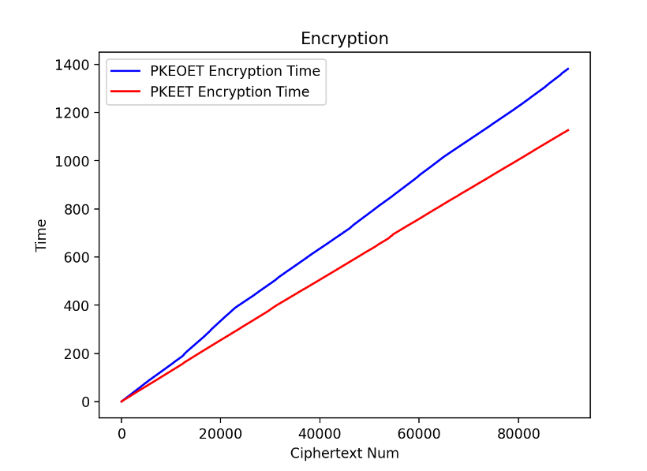
Results : Encryption

Slide 14
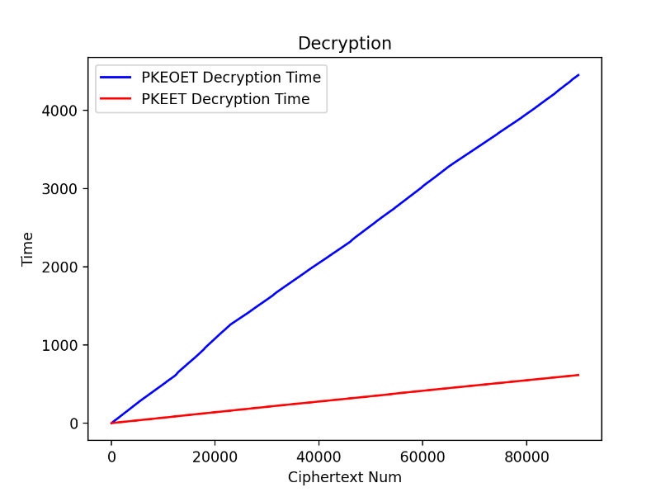
Results : Decryption

Slide 15
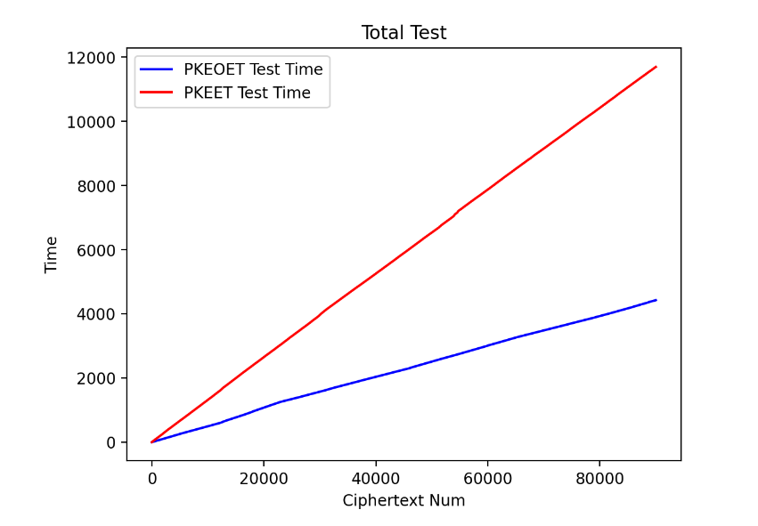
Results : Total Test

Slide 16
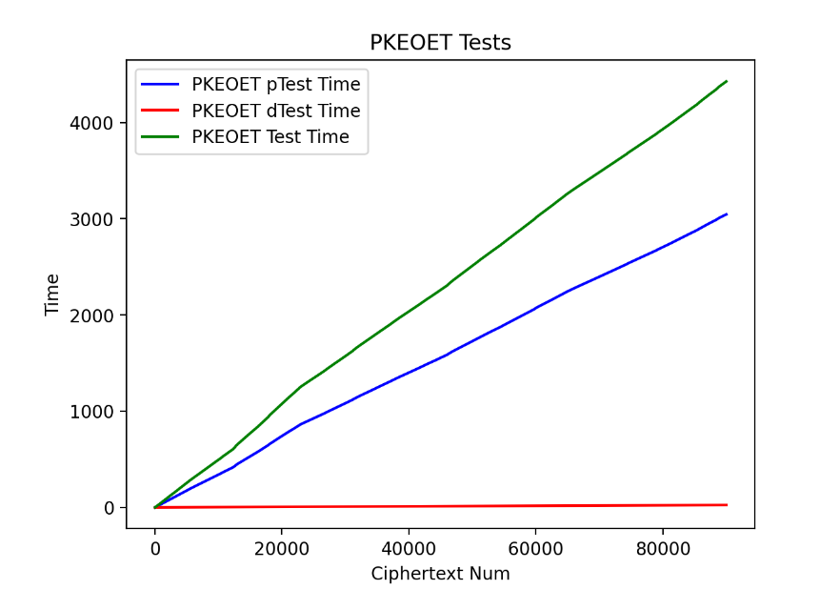
Results : PKEOET TESTs

Slide 17
Learning outcomes
Concepts of Public Key Encryption
PKEET and PKEOET methods
OMRA attacks
Limitations of PKEET
Advantages of PKEOET over PKEET
Cryptography libraries(PBC)

Slide 18
Thank You

